Slide 1
Retinal disease identification using upgraded CLAHE filter and transfer convolution neural network
Done by: Pritom Paul ID: 18101243

Slide 2
Introduction
The human eye, a vital component of vision, shares significant connections with the brain and is protected by the skull. It consists of layered structures connected by blood vessels to the retina's neural layer. Infections can affect both the eye and the central nervous system due to their shared fluid-filled cavities. Computer-aided diagnosis models offer promising solutions to these challenges, particularly in medical image analysis. Retinal diseases encompass various conditions such as diabetic retinopathy, brain tumors, and heart ailments. Techniques like fluorescein angiography and deep learning methods like Convolutional Neural Networks (CNN) aid in disease identification. Contrast enhancement methods like Contrast-Limited Adaptive Histogram Equalization (CLAHE) and transfer learning from pre-trained networks show potential for improving image quality and accuracy in medical image analysis. A proposed automated retinal disease detection model utilizes pre-trained CNNs fine-tuned for retinal diseases, achieving high accuracy through various preprocessing techniques and evaluation metrics.

Slide 3
Materials and Methods
01
Material
05
Augmentation
Step
02
Dataset Acquisition
06
Single CNNmodel
03
Fundus Preparation
07
CNN-transfer-learningapproach
04
CLAHE
Employed

Slide 4

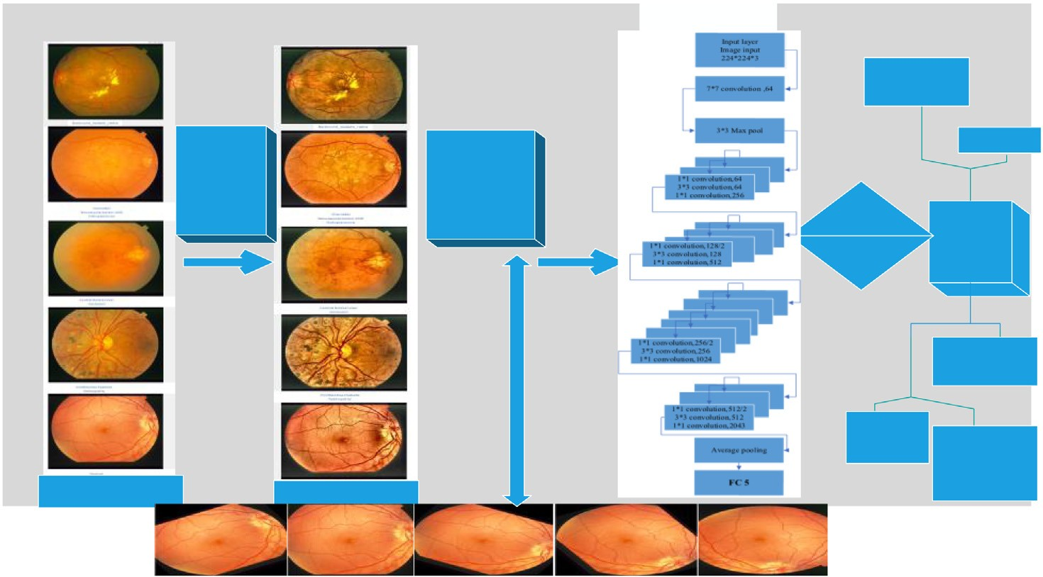








A Framework of Proposed Approach

Slide 5
Results
From the result obtain through confusion matrix, the pro- posed model resulted in zero misclassified images, recorded the sensitivity of 100.0% and specificity of 100.0%. As result, the classification model yielded an accuracy rate of 100 per- cent. The validation accuracy rose to 100 percent when the parameters were set as follows: 100 epochs, the learning rate at 0.0003, and elapsed time within 262 min. The total images after augmentation became 1800. As the RESNET50 commonly deals with the groups that have identical enumerate images, thus we adjusted the groups’ images with a software according to the smallest enumerate image classes of fundus images, which was 186 images and 960 images for training and validation in our case. The classification accuracy of the proposed RESNET50 was shown in the table displayed the training plot together with the parameters for the transfer-learning RESNET50
Validation accuracy | Training time | Training cycle | Validation frequency | Learning rate
100% | 262 min | (epoch) 100 | 65 iteration | 0.0003
=
=

Slide 6
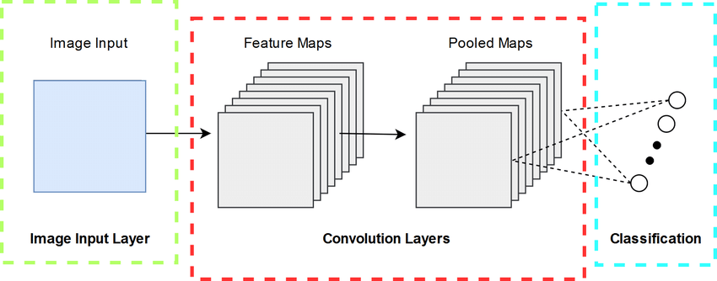
Single CNN networks
Deep learning has found extensive applications in medical image analysis and reconstruction, yet disease recognition in fundus images remains a challenge, particularly using convolutional neural networks (CNN). The study introduces a single CNN model to evaluate the impact of upgraded Contrast-Limited Adaptive Histogram Equalization (CLAHE) on fundus images. It is seen that enhanced fundus images with the proposed clipping parameter are displayed, the T/80 clipping parameter yielded the best image enhancement, as validated by accuracy tests. Overall, the proposed single CNN framework demonstrated superior performance in terms of precision and classification accuracy.

Slide 7
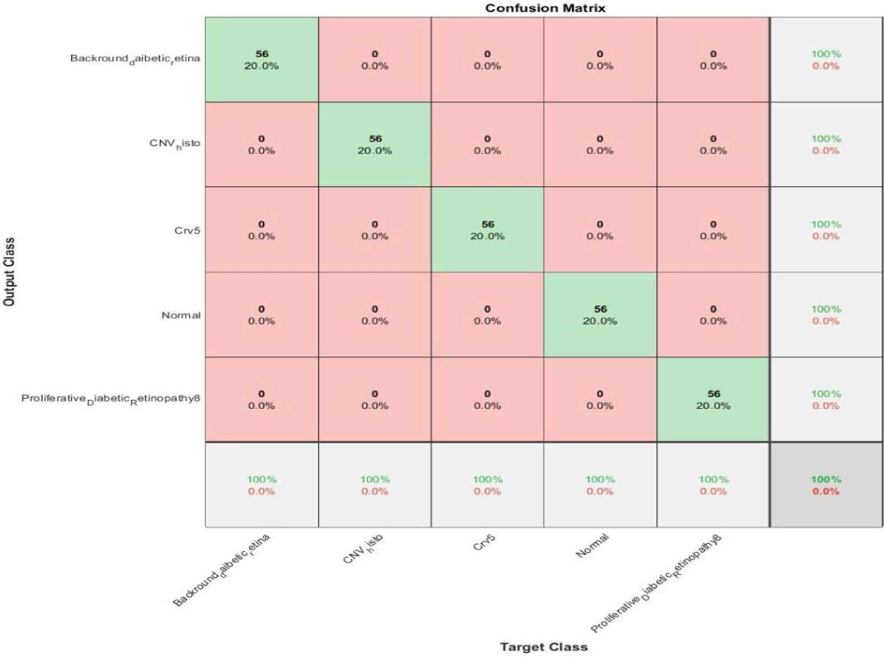
Transfer learning approach
The technique was trained on a modified CNN called RESNET50 Experimental results from RESNET50 were compared with fused features using different methods, including feature extraction and transfer learning. Notably, transfer learning exhibited the best performance. The transferred CNN effectively classified retinal diseases into respective classes while undergoing a shorter training process, in contrast to training from scratch with a thousand classes. Despite a limited training dataset, the proposed pre-trained RESNET50 network showed good classification accuracy post-augmentation, showcasing competitiveness with state-of-the-art methods in previous studies. In comparison with a prior study, the proposed framework achieved 100% classification accuracy and sensitivity, surpassing the results of the VGG19 network using the STARE database. The presented work displayed superiority in classification accuracy and deep feature extraction, even with a smaller input training dataset.

Slide 8
Conclusion
Early detection of retinal infections is imperative to prevent blindness resulting from delayed or untreated treatment. This study introduces an upgraded Contrast-Limited Adaptive Histogram Equalization (CLAHE) technique to enhance image brightness. Utilizing these improved fundus images, a CNN (RESNET50) model with transfer learning is employed to diagnose retinal illnesses. The methodology showcases notably higher accuracy in detecting such diseases compared to established methods. The model's adaptability to sudden feature changes makes it a valuable tool for ophthalmologists predicting retina diseases. However, the model's classification is restricted to five retina classes, prompting further research to broaden its disease detection capabilities. The impressive performance of the proposed model could potentially augment medical screening devices for retina observation, such as ultrasonic imaging systems or other medical detectors.
Accuracy
Network
Resnet_101 | 81.6%
DesNet_121 | 85.5%
SetNet_101 | 83.21%
WP_CNN_101 | 90.84%
Proposed model | 96.7%

